Slide 1
Elementary of Graph Algorithms
Topological Sort & Strongly Connected Components

Slide 2
DFS(V, E)
for each u ∈ V
do color[u] ← WHITE
prev[u] ← NIL
time ← 0
for each u ∈ V
do if color[u] = WHITE
then DFS-VISIT(u)
Every time DFS-VISIT(u) is called, u becomes the root of a new tree in the depth-first forest
u
v
w
x
y
z

Slide 3
DFS-VISIT(u)
color[u] ← GRAY
time ← time+1
d[u] ← time
for each v ∈ Adj[u]
do if color[v] = WHITE
then prev[v] ← u
DFS-VISIT(v)
color[u] ← BLACK
time ← time + 1
f[u] ← time
u
v
w
x
y
z
time = 1
u
v
w
1/
x
y
z
u
v
w
1/
2/
x
y
z

Slide 4
Example
u
v
w
u
v
w
u
v
w
1/
1/
2/
1/
2/
3/
x
y
z
x
y
z
x
y
z
u
v
w
u
v
w
u
v
w
1/
2/
1/
2/
1/
2/
B
B
4/
3/
4/
3/
4/5
3/
x
y
z
x
y
z
x
y
z
u
v
w
u
v
w
u
v
w
1/
2/
1/
2/7
1/
2/7
B
B
F
B
4/5
3/6
4/5
3/6
4/5
3/6
x
y
z
x
y
z
x
y
z

Slide 5
Example (cont.)
u
v
w
u
v
w
u
v
w
1/8
2/7
1/8
2/7
9/
1/8
2/7
9/
B
B
C
F
B
F
F
4/5
3/6
4/5
3/6
4/5
3/6
x
y
z
x
y
z
x
y
z
u
v
w
u
v
w
u
v
w
1/8
2/7
9/
1/8
2/7
9/
1/8
2/7
9/
B
C
B
C
B
C
F
F
B
F
B
4/5
3/6
10/
4/5
3/6
10/
4/5
3/6
10/11
x
y
z
x
y
z
x
y
z
u
v
w
The results of DFS may depend on:
  The order in which nodes are explored in procedure DFS
  The order in which the neighbors of a vertex are visited in DFS-VISIT
1/8
2/7
9/12
B
C
F
B
4/5
3/6
10/11
x
y
z

Slide 6
Edge Classification
Tree edge (reaches a WHITE vertex):
  (u, v) is a tree edge if v was first discovered by exploring edge (u, v)
Back edge (reaches a GRAY vertex):
  (u, v), connecting a vertex u to an ancestor v in a depth first tree
  Self loops (in directed graphs) are also back edges
u
v
w
1/
x
y
z
u
v
w
1/
2/
B
4/
3/
x
y
z

Slide 7
Edge Classification
Forward edge (reaches a BLACK vertex & d[u] < d[v]):
  Non-tree edges (u, v) that connect a vertex u to a descendant v in a depth first tree
Cross edge (reaches a BLACK vertex & d[u] > d[v]):
  Can go between vertices in same depth-first tree (as long as there is no ancestor / descendant relation) or between different depth-first trees
u
v
w
1/
2/7
F
B
4/5
3/6
x
y
z
u
v
w
1/8
2/7
9/
B
C
F
4/5
3/6
x
y
z

Slide 8
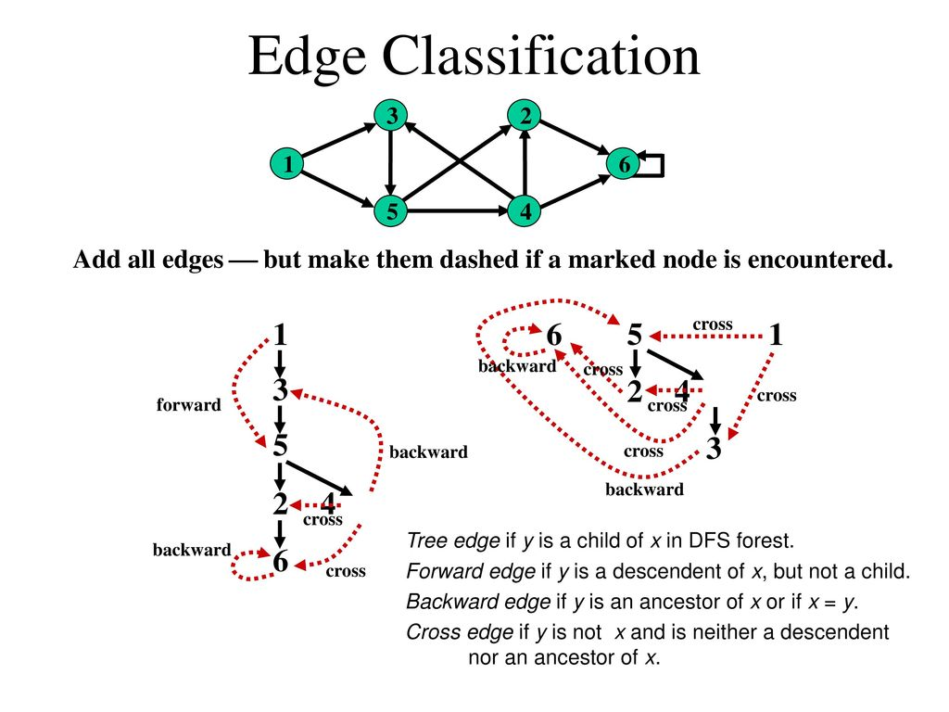

CS 477/677 - Lecture 19

Slide 9
Analysis of DFS(V, E)
for each u ∈ V
do color[u] ← WHITE
π[u] ← NIL
time ← 0
for each u ∈ V
do if color[u] = WHITE
then DFS-VISIT(u)
Θ(V)
Θ(V) – exclusive of time for
DFS-VISIT

Slide 10
Analysis of DFS-VISIT(u)
color[u] ← GRAY
time ← time+1
d[u] ← time
for each v ∈ Adj[u]
do if color[v] = WHITE
then π[v] ← u
DFS-VISIT(v)
color[u] ← BLACK
time ← time + 1
f[u] ← time
DFS-VISIT is called exactly once for each vertex
Each loop takes
|Adj[v]|
Total: Σ_{v∈V} |Adj[v]| + Θ(V) =
Θ(V + E)
Θ(E)

Slide 11
Properties of DFS
u = prev[v] ⇔ DFS-VISIT(v) was called during a search of u’s adjacency list
Vertex v is a descendant of vertex u in the depth first forest ⇔ v is discovered during the time in which u is gray
u
v
w
1/
2/
3/
x
y
z

Slide 12
Parenthesis Theorem
In any DFS of a graph G, for all u, v, exactly one of the following holds:
[d[u], f[u]] and [d[v], f[v]] are disjoint, and neither of u and v is a descendant of the other
[d[v], f[v]] is entirely within [d[u], f[u]] and v is a descendant of u
[d[u], f[u]] is entirely within [d[v], f[v]] and u is a descendant of v
y
z
s
t
3/6
2/9
1/10
11/16
4/5
7/8
12/13
14/15
x
w
v
u
s
t
z
v
u
y
w
x
1
2
3
4
5
6
7
8
9
10
11
12
13
14
15
16
(s
(z
(y
(x
x)
y)
(w
w)
z)
s)
(t
(v
u)
(u
u)
t)
Well-formed expression: parenthesis are
properly nested

Slide 13
Other Properties of DFS
Corollary
Vertex v is a proper descendant of u
⇔ d[u] < d[v] < f[v] < f[u]
Theorem (White-path Theorem)
In a depth-first forest of a graph G, vertex v is a descendant of u if and only if at time d[u], there is a path u  v consisting of only white vertices.
u
1/8
2/7
9/12
B
C
F
B
4/5
3/6
10/11
v
u
1/
2/
v

Slide 14
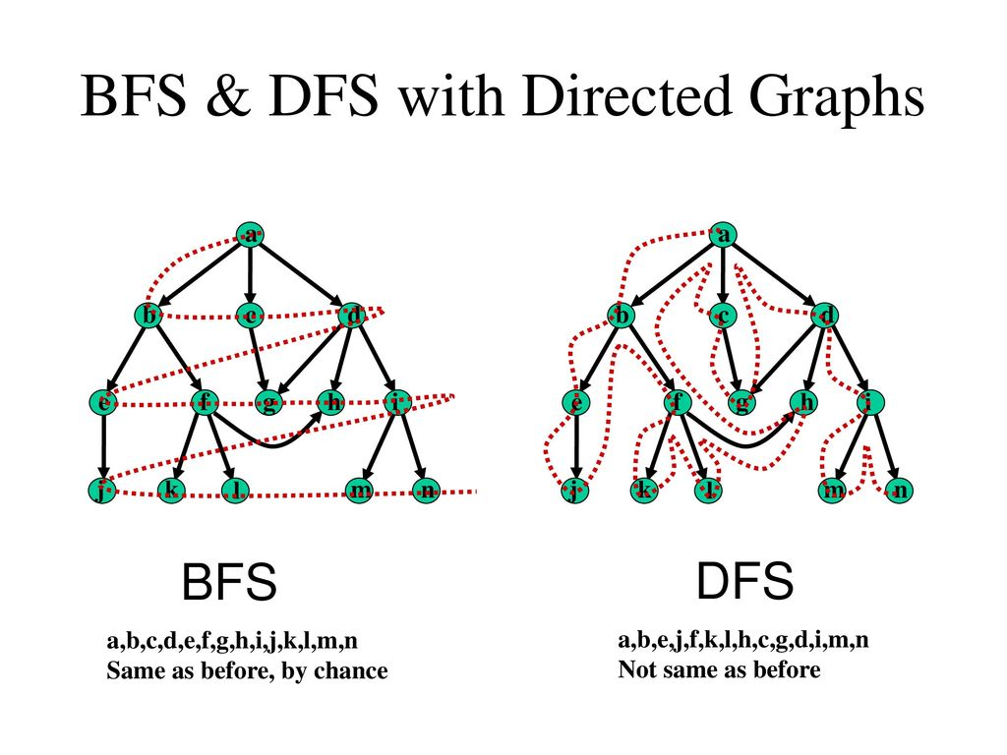
BFS vs. DFS
CS 477/677 - Lecture 19

Slide 15
Directed Acyclic Graph
DAG – Directed graph with no cycles.
Good for modeling processes and structures that have a partial order:
  a > b and b > c ⇒ a > c.
  But may have a and b such that neither a > b nor b > a.
Can always make a total order (either a > b or b > a for all a ≠ b) from a partial order.

Slide 16
Characterizing a DAG
Lemma 22.11
A directed graph G is acyclic iff a DFS of G yields no back edges.
T
T
T
v
u
B

Slide 17
Topological Sort
Topological sort of a directed acyclic graph G = (V, E): a linear order of vertices such that if there exists an edge (u, v), then u appears before v in the ordering.
Directed acyclic graphs (DAGs)
  Used to represent precedence of events or processes that have a partial order
  a before b b before c
  b before c a before c
What about
a and b?
a before c
Topological sort helps us establish a total order

Slide 18
Topological Sort
Want to “sort” a directed acyclic graph (DAG).
A
B
D
C
E
A
B
C
D
E
Think of original DAG as a partial order.
Want a total order that extends this partial order.

Slide 19
Topological Sort - Application
Application 1
  in scheduling a sequence of jobs.
  The jobs are represented by vertices,
  there is an edge from x to y if job x must be completed before job y can be done
    (for example, washing machine must finish before we put the clothes to dry). Then, a topological sort gives an order in which to perform the jobs
Application 2
  In open credit system, how to take courses (in order) such that, pre-requisite of courses will not create any problem

Slide 20

Topological Sort (Fig – Cormen)
undershorts
11/
16
17/
18
socks
TOPOLOGICAL-SORT(V, E)
Call DFS(V, E) to compute finishing times f[v] for each vertex v
When each vertex is finished, insert it onto the front of a linked list
Return the linked list of vertices
12/
15
pants
shoes
13/
14
1/
shirt
8
6/
7
belt
watch
9/
10
tie
2/
5
jacket
3/
4
socks
undershorts
pants
shoes
watch
shirt
belt
tie
jacket
Running time: Θ(V + E)

Slide 21
Readings
Cormen - Chapter 22
Exercise:
  22.4-2 : Number of paths (important)
  22.4-3 : cycle (important and we have already solved it)
  22.4-5 : Topological sort using degree

Slide 22
Strongly Connected Component

Slide 23
Last Class’s Topic
DFS
Topological Sort
Problems:
  Detect cycle in an undirected graph
  Detect cycle in a directed graph
  How many paths are there from “s” to “t” in a directed acyclic graph?

Slide 24
Connectivity
Connected Graph
  In an undirected graph G, two vertices u and v are called connected if G contains a path from u to v. Otherwise, they are called disconnected.
  A directed graph is called connected if every pair of distinct vertices in the graph is connected.
Connected Components
  A connected component is a maximal connected subgraph of G. Each vertex belongs to exactly one connected component, as does each edge.

Slide 25
Connectivity (cont.)
Weakly Connected Graph
  A directed graph is called weakly connected if replacing all of its directed edges with undirected edges produces a connected (undirected) graph.
Strongly Connected Graph
  It is strongly connected or strong if it contains a directed path from u to v for every pair of vertices u, v. The strong components are the maximal strongly connected subgraphs

Slide 26
Connected Components
Strongly connected graph
  A directed graph is called strongly connected if for every pair of vertices u and v there is a path from u to v and a path from v to u.
Strongly Connected Components (SCC)
  The strongly connected components (SCC) of a directed graph are its maximal strongly connected subgraphs.
Here, we work with
  Directed unweighted graph

Slide 27
Strongly Connected Components
G is strongly connected if every pair (u, v) of vertices in G is reachable from one another.
A strongly connected component (SCC) of G is a maximal set of vertices C ⊆ V such that for all u, v ∈ C, both u v and v u exist.

Slide 28
DFS - Strongly Connected Components
A
C
E
G
B
D
F
H

Slide 29
DFS - Strongly Connected Components
A
C
E
G
B
D
F
H

Slide 30
Component Graph
G^{SCC} = (V^{SCC}, E^{SCC}).
V^{SCC} has one vertex for each SCC in G.
E^{SCC} has an edge if there’s an edge between the corresponding SCC’s in G.
G^{SCC} for the example considered:

Slide 31
Strongly Connected Components
The transpose M^{T} of an NxN matrix M is the matrix obtained
when the rows become columns and the column become rows:
a
d
G
a
d
G^{T}
b
c
Edges
have reverse
direction!
b
c
M
a b c d
a b c d
M^{T}
a
b
c
d
1
a
b
c
d
1
1
1
1
1
1
1

Slide 32
Transpose of a Directed Graph
G^{T} = transpose of directed G.
  G^{T} = (V, E^{T}), E^{T} = {(u, v) : (v, u) ∈ E}.
  G^{T} is G with all edges reversed.
Can create G^{T} in Θ(V + E) time if using adjacency lists.
G and G^{T} have the same SCC’s. (u and v are reachable from each other in G if and only if reachable from each other in G^{T}.)

Slide 33
Algorithm to determine SCCs
SCC(G)
call DFS(G) to compute finishing times f [u] for all u
compute G^{T}
call DFS(G^{T}), but in the main loop, consider vertices in order of decreasing f [u] (as computed in first DFS)
output the vertices in each tree of the depth-first forest formed in second DFS as a separate SCC
Time: Θ(V + E).

Slide 34
Example
a
b
c
d
13/
14
11/
16
1/
10
8/
9
DFS on the initial graph G
b
16
e
15
a
14
c
10
d
9
g
7
h
6
f
4
3/
4
2/
7
5/
12/
15
6
e
f
g
h
a
b
c
d
DFS on G^{T:}
start at b: visit a, e
start at c: visit d
start at g: visit f
start at h
e
f
g
h
Strongly connected components: C₁ = {a, b, e}, C₂ = {c, d}, C₃ = {f, g}, C₄ = {h}

Slide 35
Component Graph
a
b
c
d
c d
a b e
f g
h
e
f
g
h
The component graph G^{SCC} = (V^{SCC}, E^{SCC}):
  V^{SCC} = {v₁, v₂, …, v_{k}}, where v_{i} corresponds to each strongly connected component C_{i}
  There is an edge (v_{i}, v_{j}) ∈ E^{SCC} if G contains a directed edge (x, y) for some x ∈ C_{i} and y ∈ C_{j}
The component graph is a DAG

Slide 36
Lemma 1
Let C and C’ be distinct SCCs in G
Let u, v ∈ C, and u’, v’ ∈ C ’
Suppose there is a path u  u’ in G
Then there cannot also be a path v’  v in G.
Proof
Suppose there is a path v’  v
There exists u  u’  v’
There exists v’  v  u
u and v’ are reachable from each other, so they are not in separate SCC’s: contradiction!
C
C’
u
u’
v
v’

Slide 37
Notations
Extend notation for d (starting time) and f (finishing time) to sets of vertices U ⊆ V:
  d(U) = min_{u∈U} { d[u] } (earliest discovery time)
  f(U) = max_{u∈U} { f[u] } (latest finishing time)
C₁
C₂
a
b
c
d
d(C₁)
=11
d(C₂)
=1
13/
14
11/
16
1/
10
8/
9
f(C₂)
f(C₁)
=16
=10
3/
4
2/
7
5/
12/
15
6
e
f
g
h
C₃
C₄
d(C₃)
=2
d(C₄)
=5
f(C₃)
=7
f(C₄)
=6

Slide 38
Lemma 2
Let C and C’ be distinct SCCs in a directed graph G = (V, E). If there is an edge (u, v) ∈ E, where u ∈ C and v ∈ C’ then f(C) > f(C’).
Consider C₁ and C₂, connected by edge (b, c)
C₁
C₂
a
b
c
d
d(C₁)
=11
d(C₂)
=1
13/
14
11/
16
1/
10
8/
9
f(C₂)
f(C₁)
=16
=10
3/
4
2/
7
5/
12/
15
6
e
f
g
h
C₃
C₄
d(C₃)
=2
d(C₄)
=5
f(C₃)
=7
f(C₄)
=6

Slide 39
Corollary
Let C and C’ be distinct SCCs in a directed graph G = (V, E). If there is an edge (u, v) ∈ E^{T}, where u ∈ C and v ∈ C’ then f(C) < f(C’).
Consider C₂ and C₁, connected by edge (c, b)
C₁ = C’
C₂ = C
Since (c, b) ∈ E^{T} ⇒ (b, c) ∈ E
From previous lemma:
f(C₁) > f(C₂)
f(C’) > f(C)
f(C) < f(C’)
a
b
c
d
e
f
g
h
C₃
C₄

Slide 40
Corollary
Each edge in G^{T} that goes between different components goes from a component with an earlier finish time (in the DFS) to one with a later finish time
C₁ = C’
C₂ = C
a
b
c
d
e
f
g
h
C₃
C₄

Slide 41
Why does SCC Work?
When we do the second DFS, on G^{T}, we start with a component C such that f(C) is maximum (b, in our case)
We start from b and visit all vertices in C₁
From corollary: f(C) > f(C’) in G for all C ≠ C’ ⇒ there are no edges from C to any other SCCs in G^{T}
⇒ DFS will visit only vertices in C₁
⇒ The depth-first tree rooted at b contains exactly the vertices of C₁
C₁
C₂
a
b
c
d
b
16
e
15
a
14
c
10
d
9
g
7
h
6
f
4
C₃
C₄
e
f
g
h

Slide 42
Why does SCC Work? (cont.)
The next root chosen in the second DFS is in SCC C₂ such that f(C) is maximum over all SCC’s other than C₁
DFS visits all vertices in C₂
  the only edges out of C₂ go to C₁, which we’ve already visited
⇒ The only tree edges will be to vertices in C₂
Each time we choose a new root it can reach only:
  vertices in its own component
  vertices in components already visited
C₁
C₂
a
b
c
d
b
16
e
15
a
14
c
10
d
9
g
7
h
6
f
4
C₃
C₄
e
f
g
h

Slide 43
Reference
Book: Cormen – Chapter 22 – Section 22.5
Exercise:
  22.5-1: Number of componets change?
  22.5-6: Minimize edge list
  22.5-7: Semiconnected graph

